Slide 1



Find-X: UIU Lost and Found Management System
DBMS Project Presentation

Slide 2
Project’s Team Name:
Team Find-X
Submitted to:
Mr. Farhan Anan Himu
Lecturer
Department of Computer Science and Engineering

Slide 3
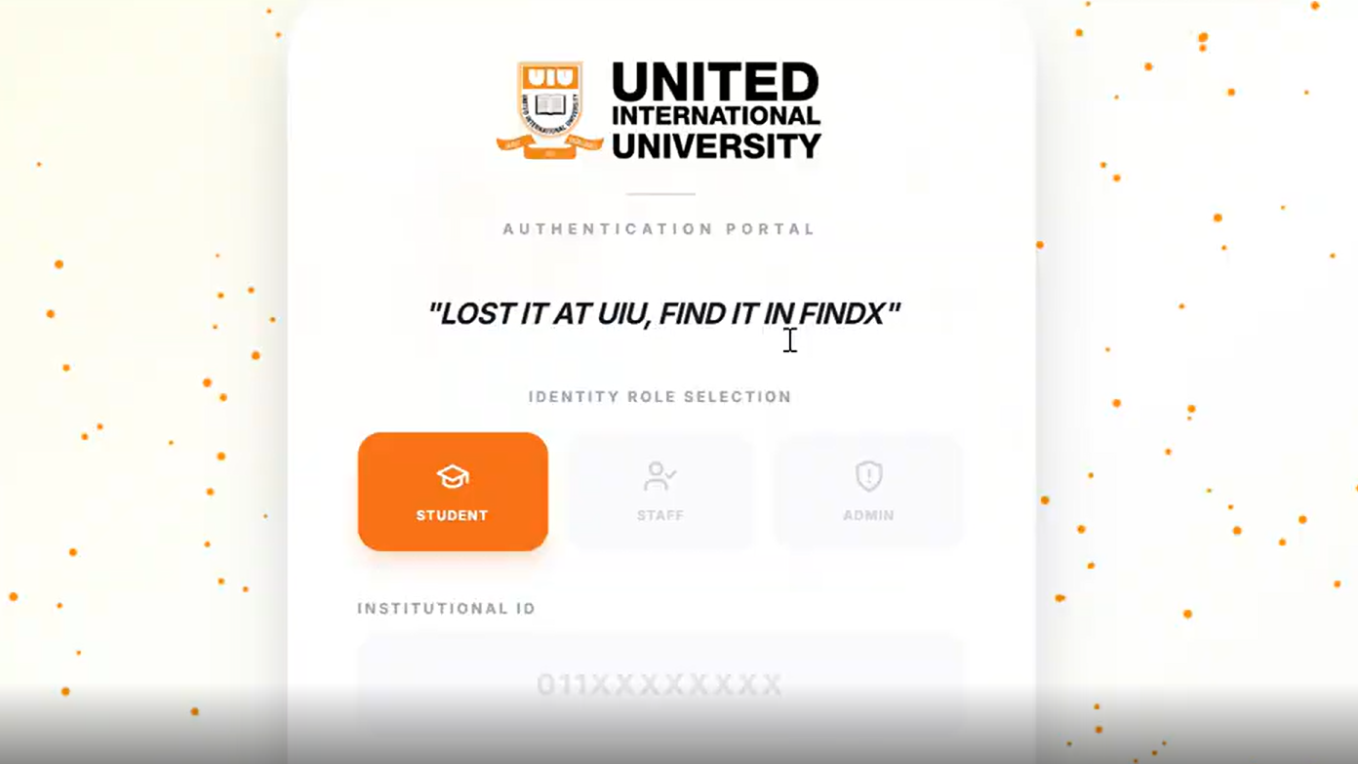
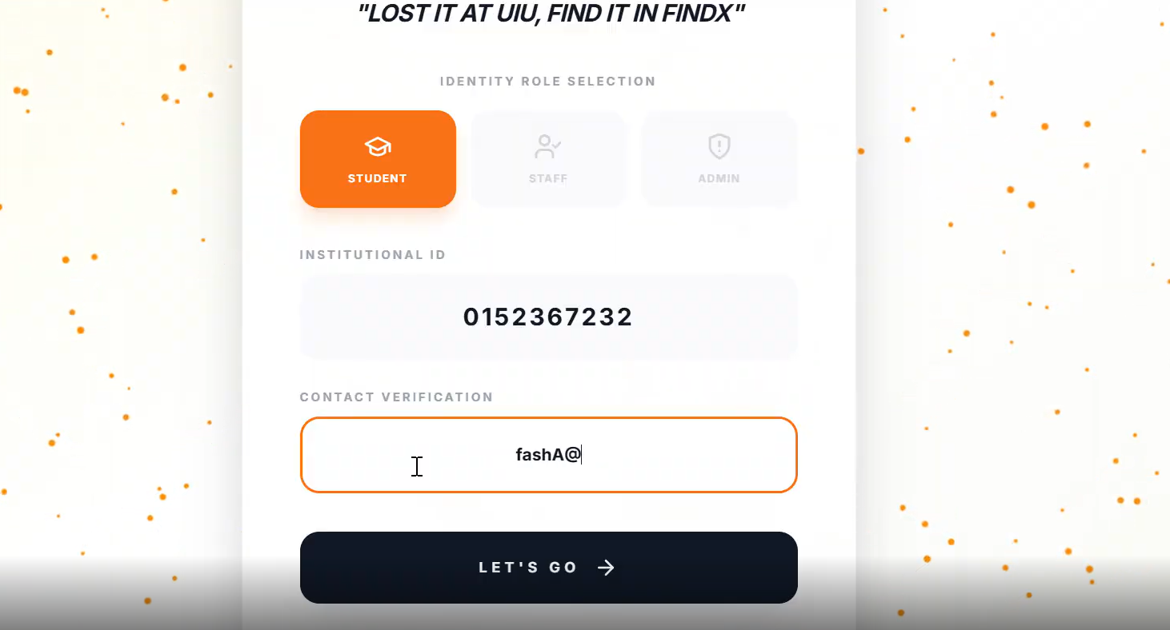
Users begin by selecting their role as Student, Staff, or Admin. This ensures that each user can access only the features permitted for their role.
Users authenticate themselves using their UIU ID and verified contact information. This step ensures secure and accountable access to the system.

Slide 4
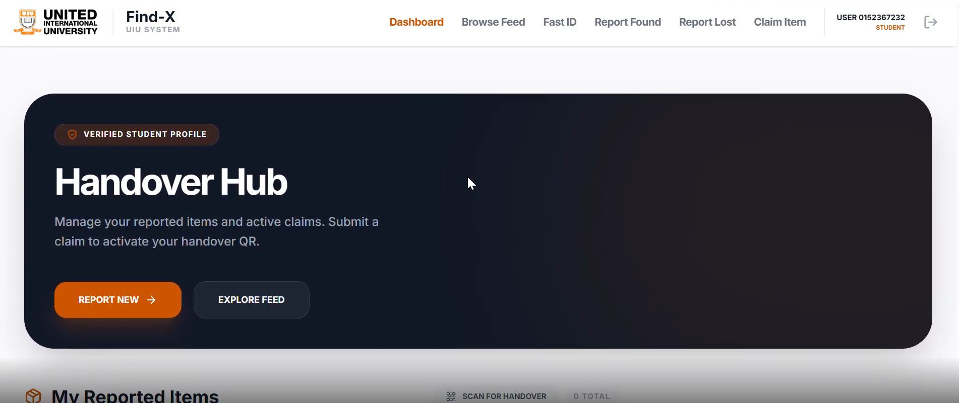
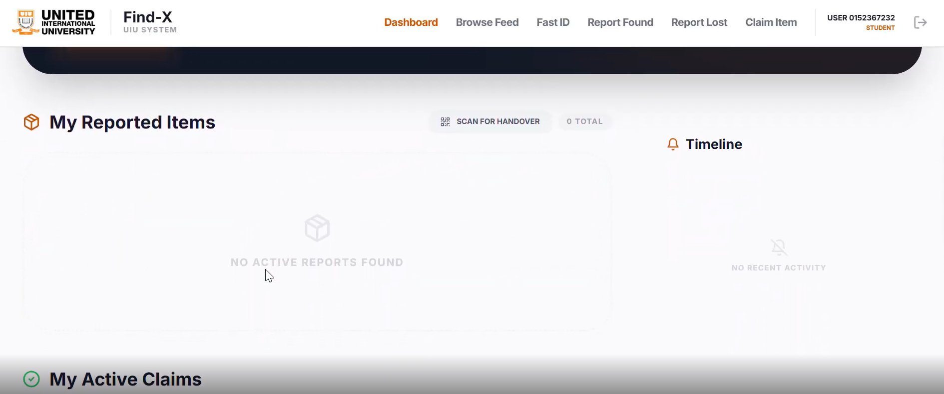
This dashboard allows users to manage their reported items and active claims. From here, users can report new items and initiate the handover process.
This section displays all items reported by the user. Users can track the current status and timeline of each reported item.

Slide 5
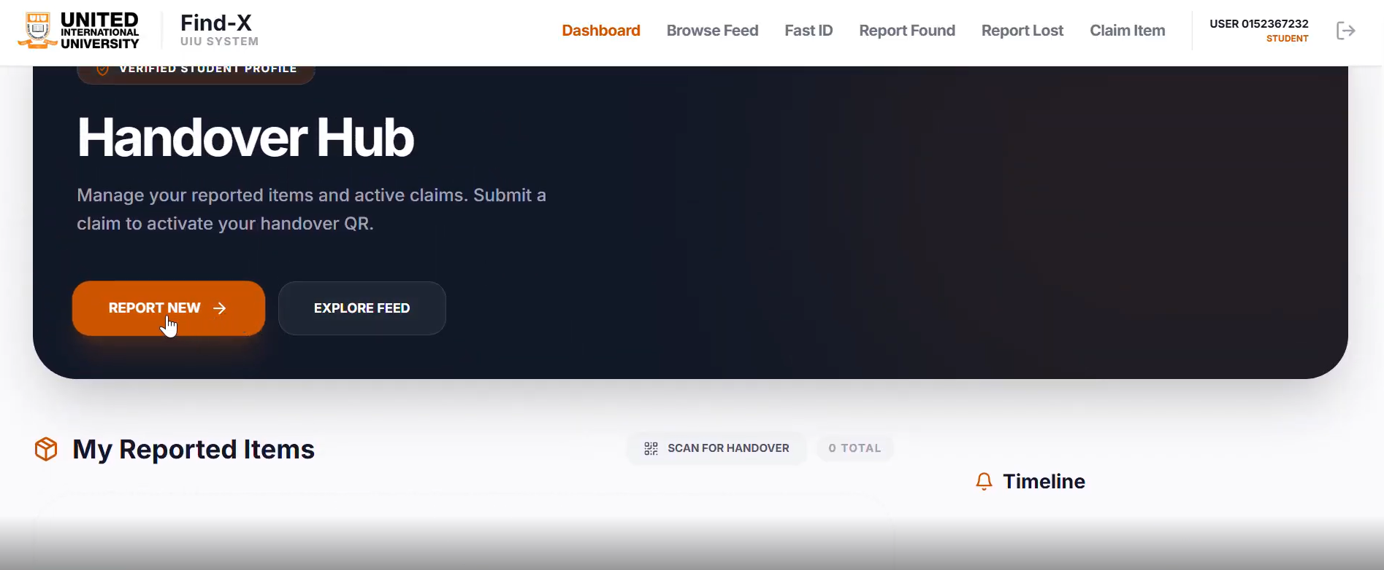
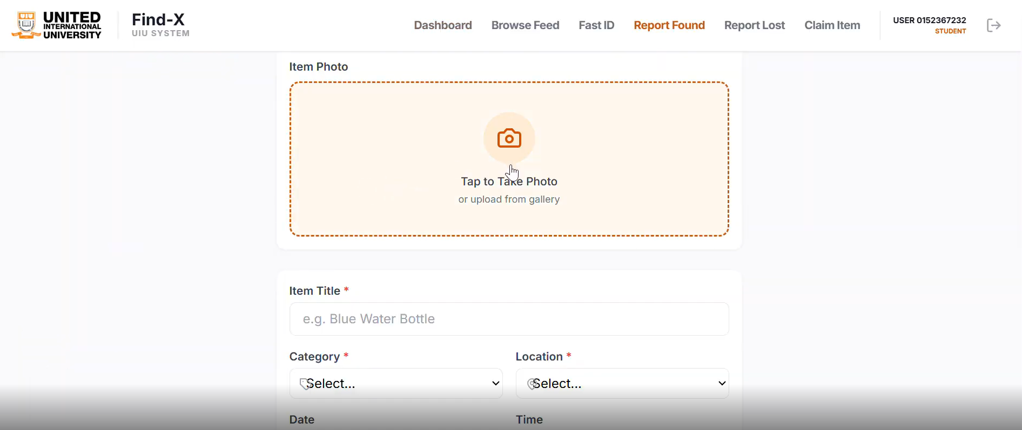
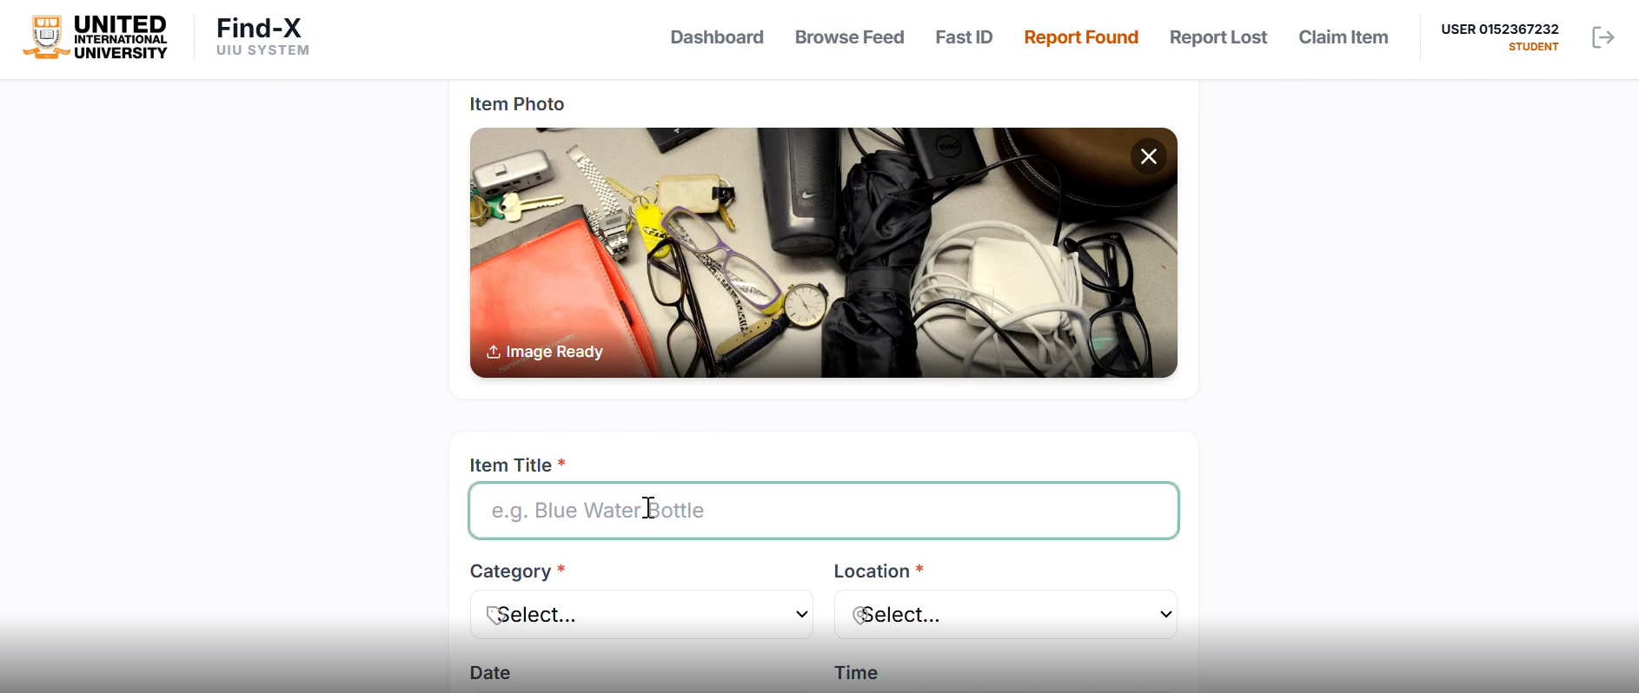
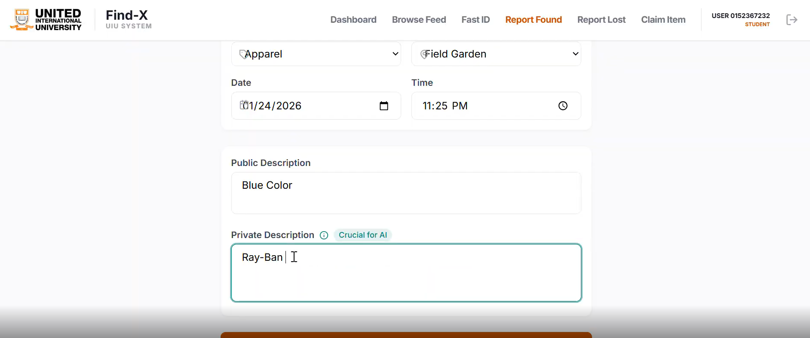

Slide 6
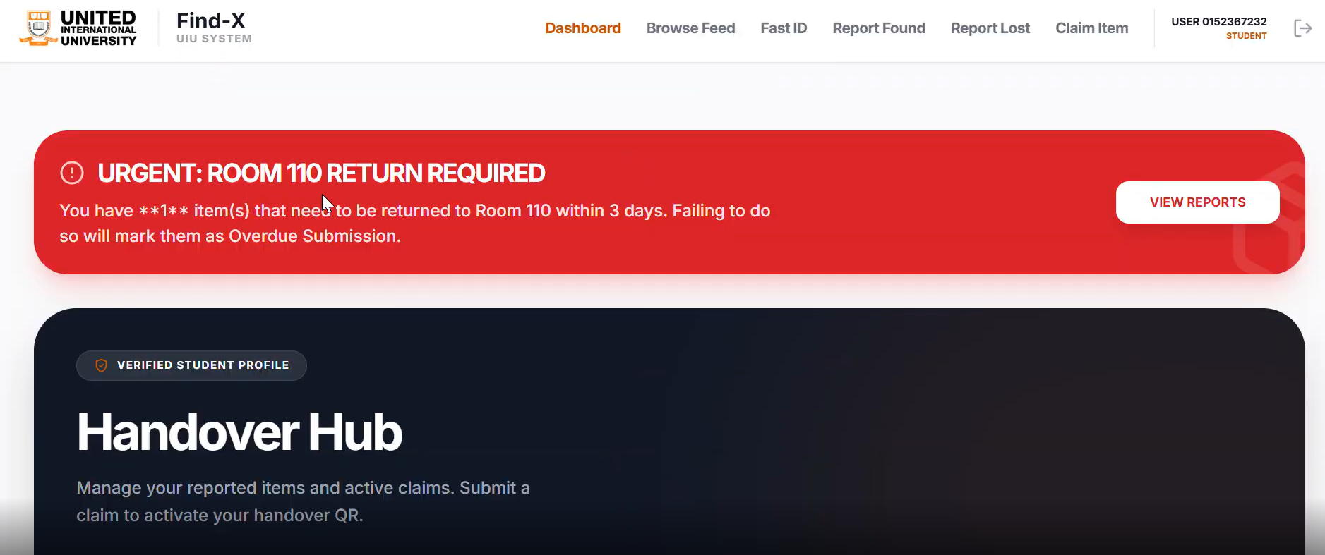

Slide 7
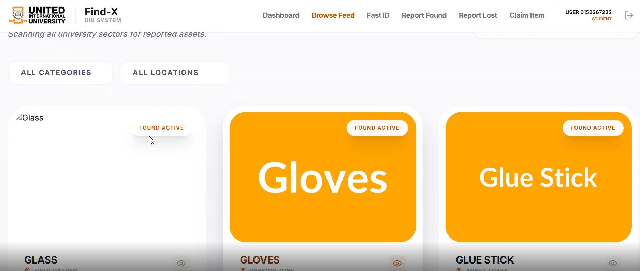
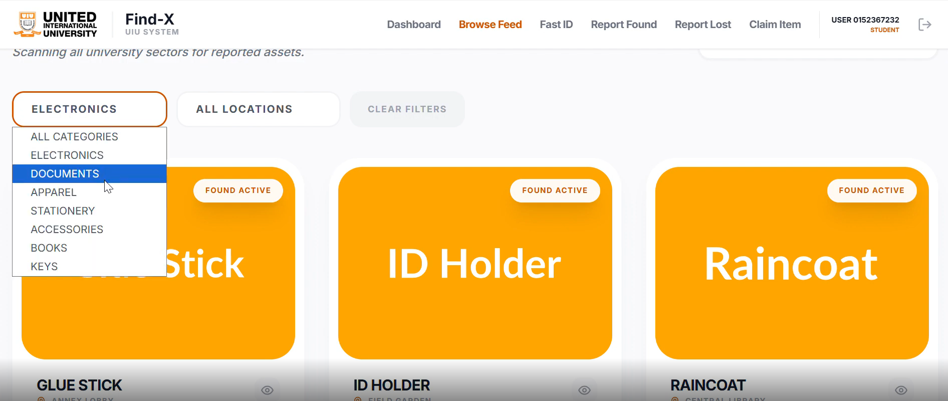
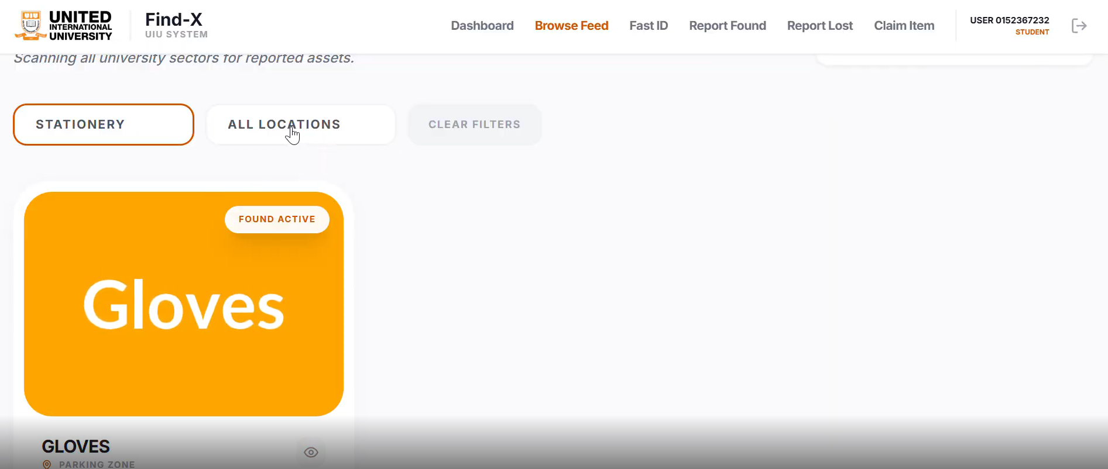
1.Displays all found items without applying any category filter, allowing users to browse the complete list.
3.After selecting a specific category ,only the items belonging to that category are displayed.
2.Shows the category selection dropdown, where users can choose from options such as Electronics, Documents, Stationery, etc.

Slide 8
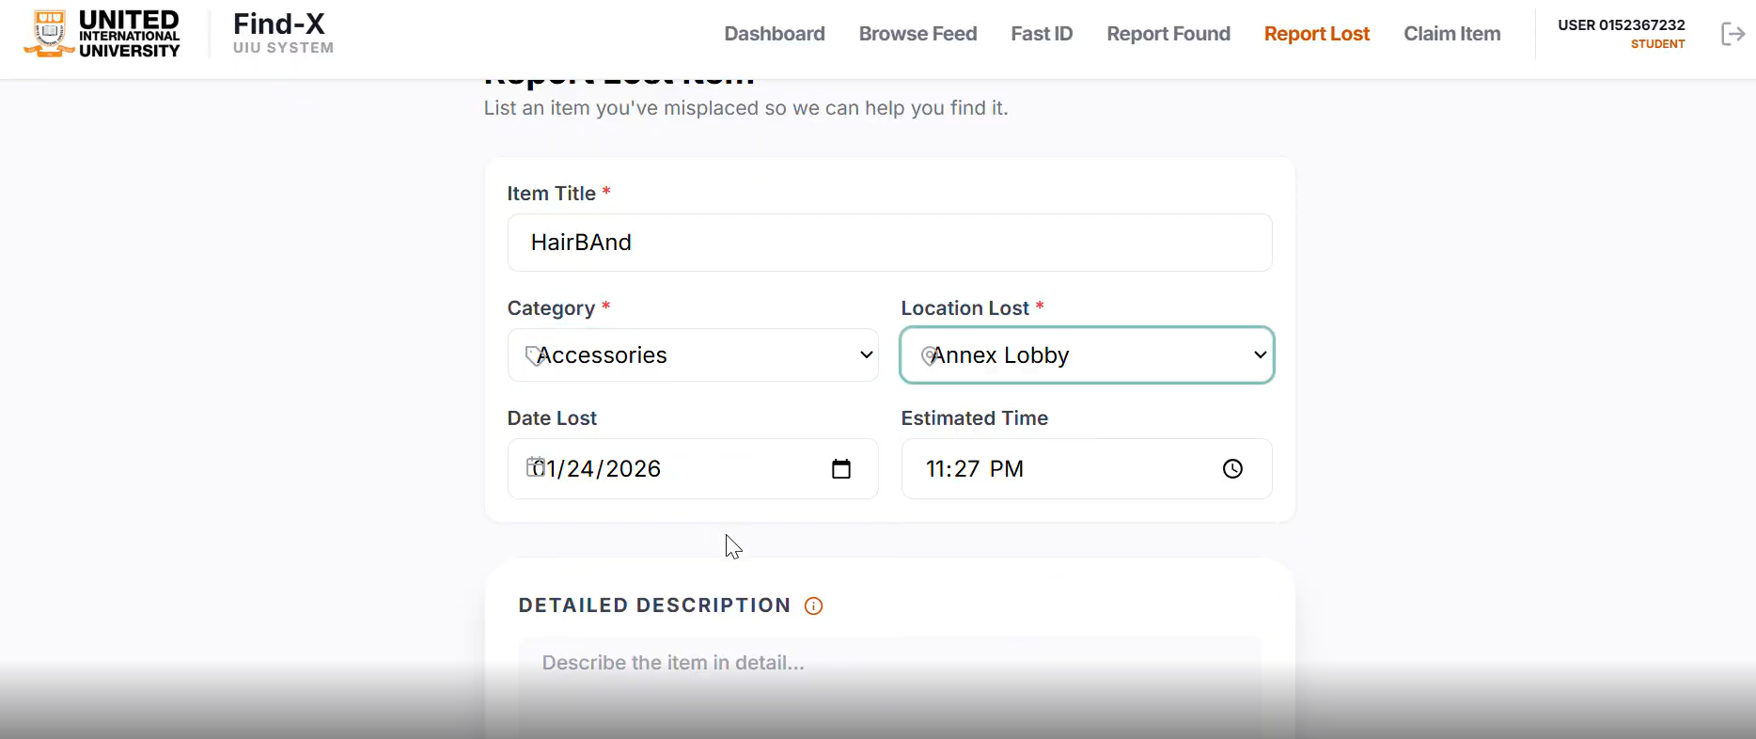
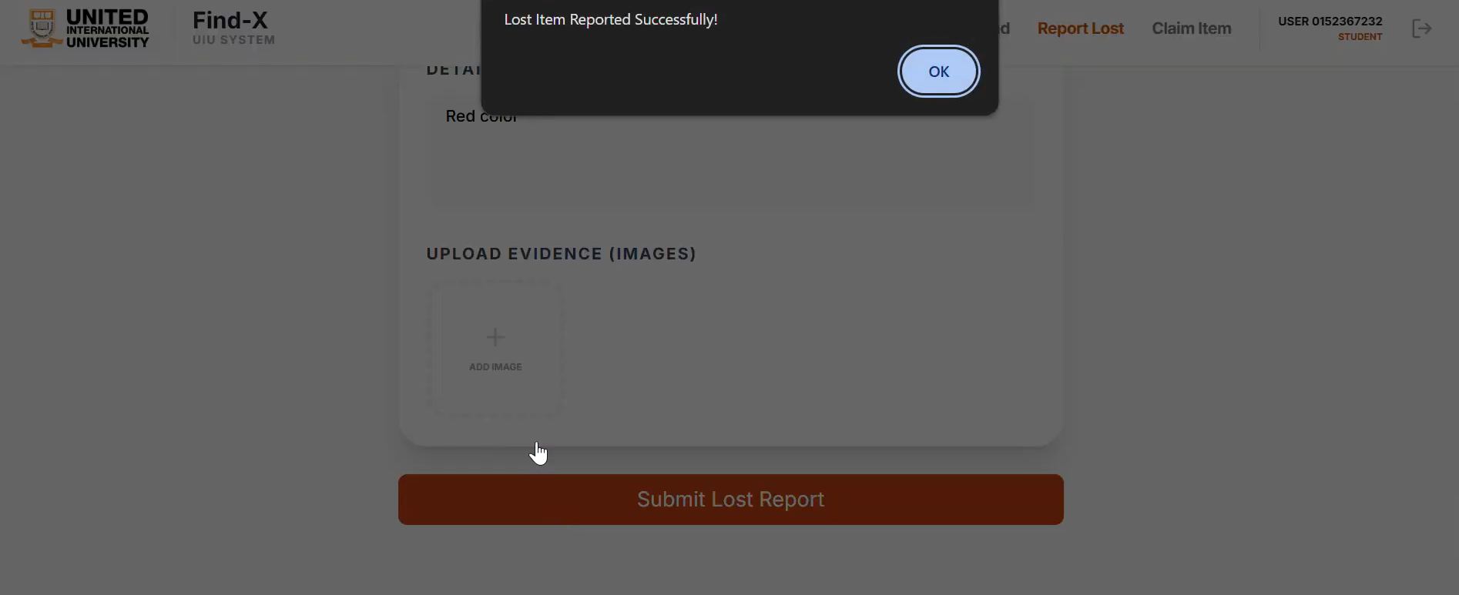
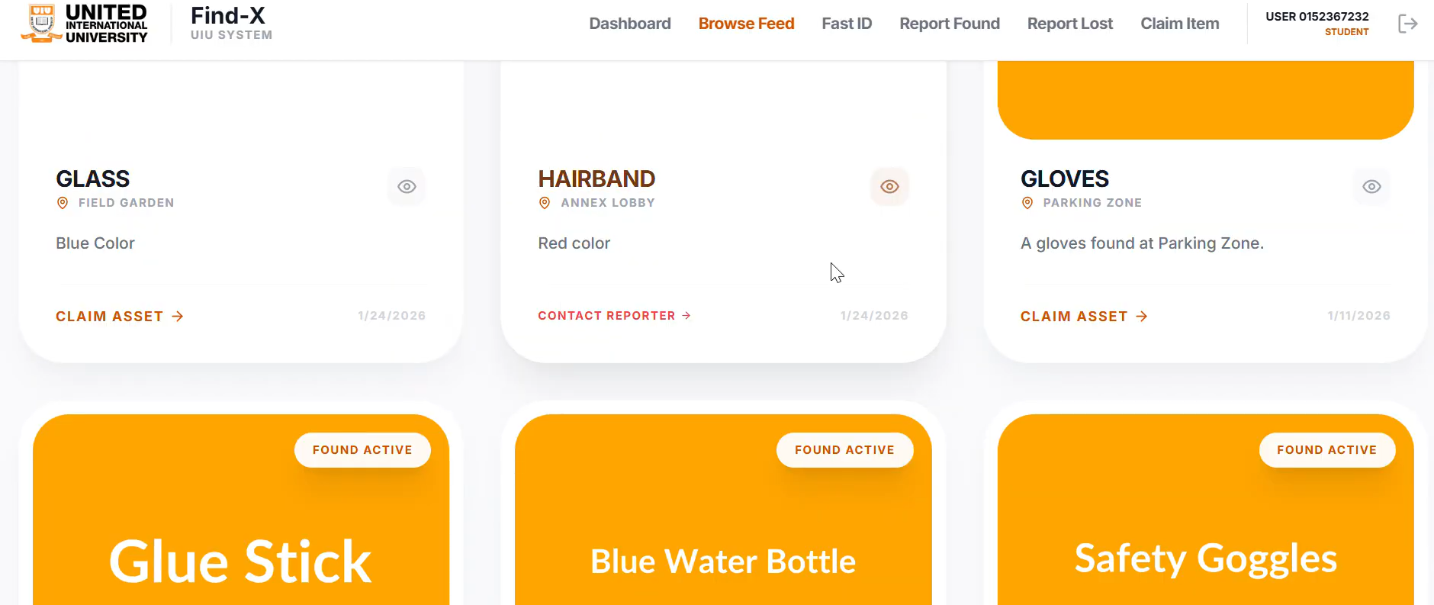
This slide shows the lost item reporting form where users provide basic details such as item name, category, and location.
This slide displays a list of found items, where users can view details and claim their lost items easily.
In this slide, users can upload images as evidence and submit their lost item report for verification.

Slide 9
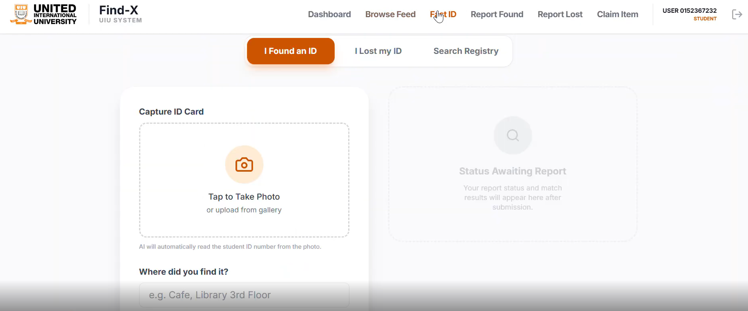
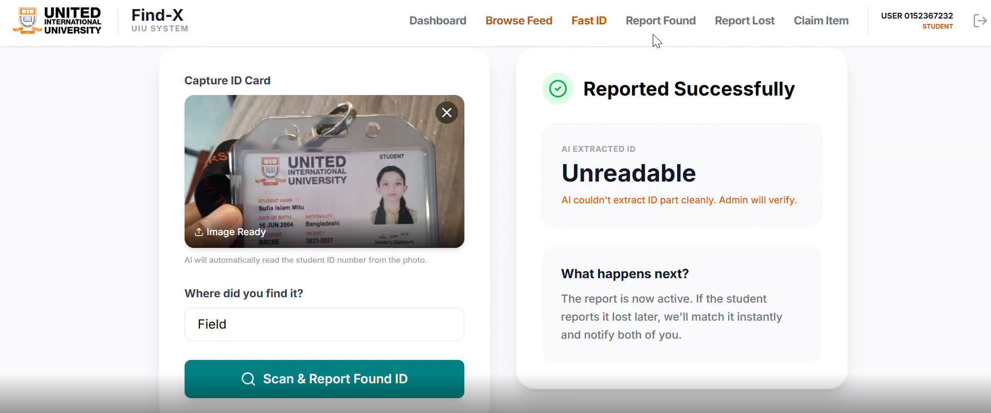
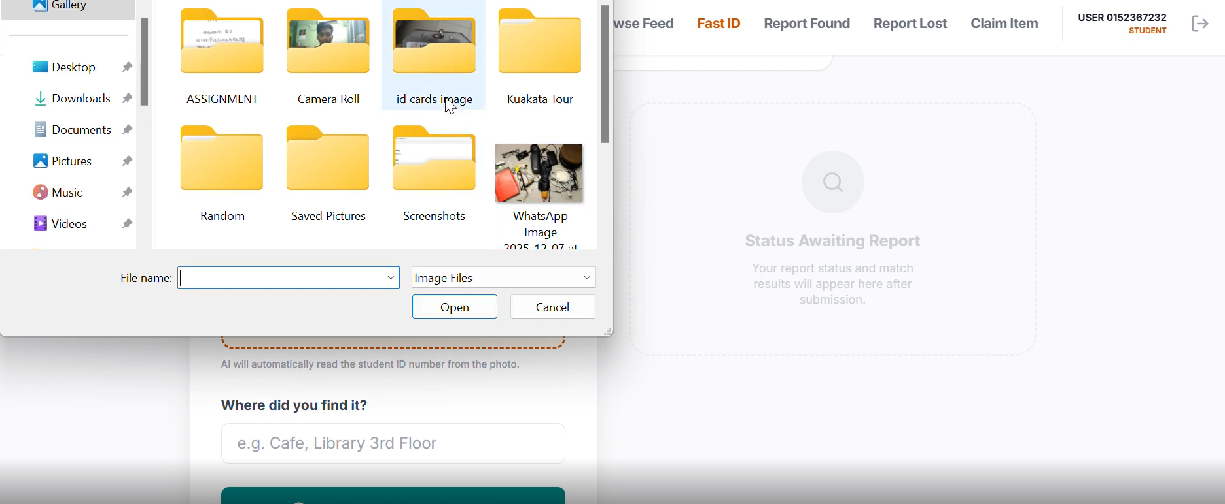

Slide 10
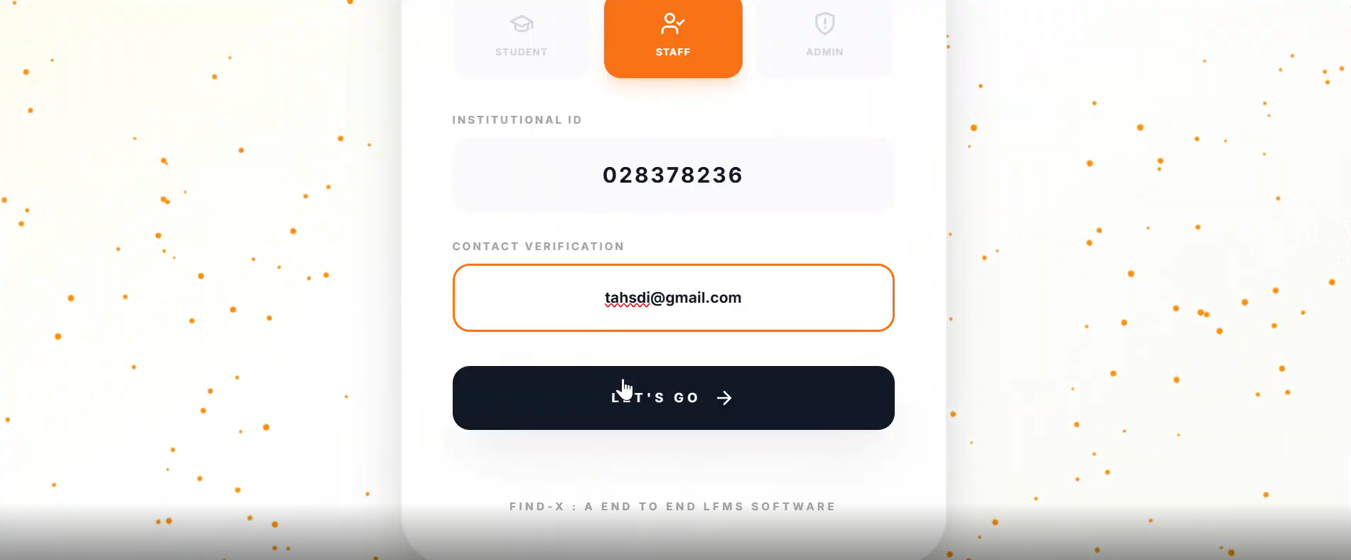
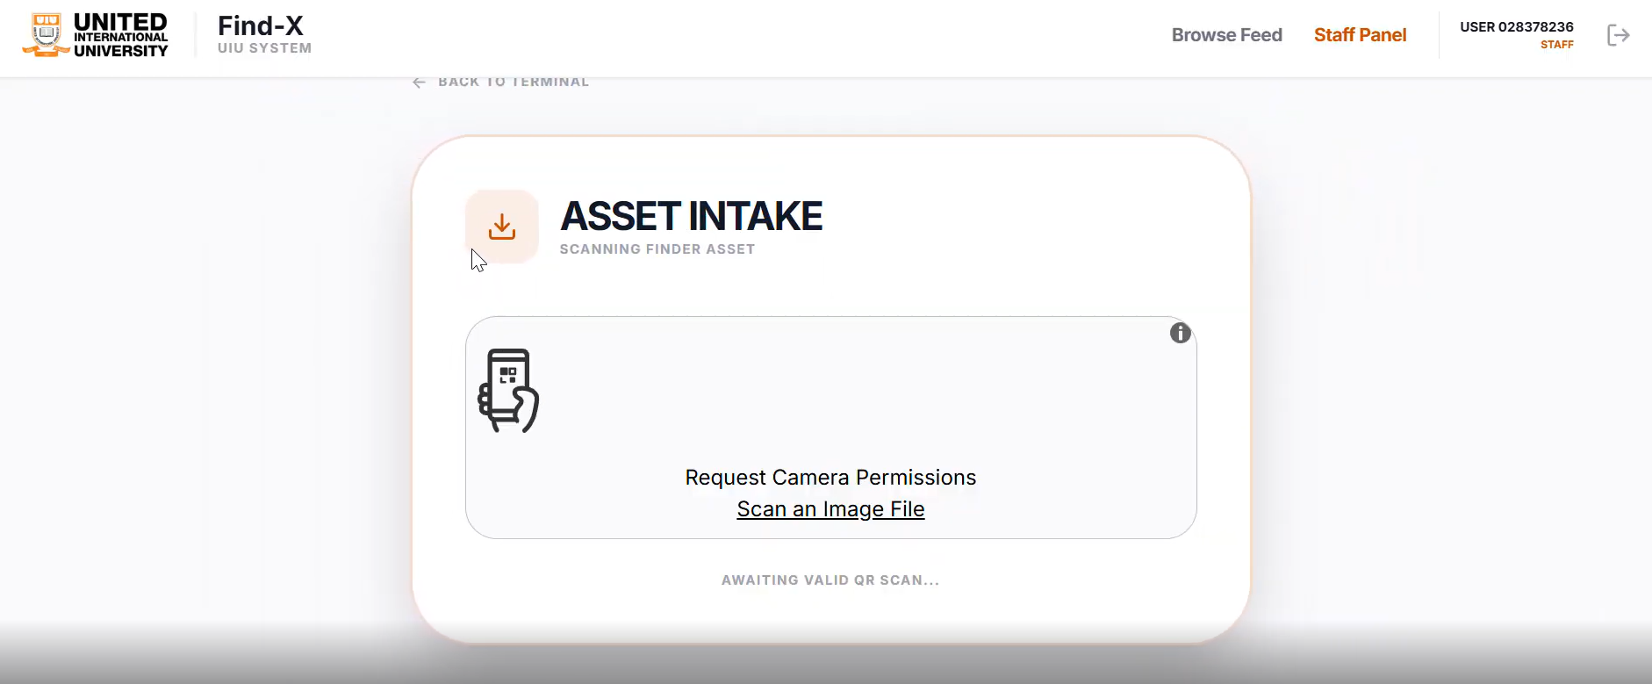
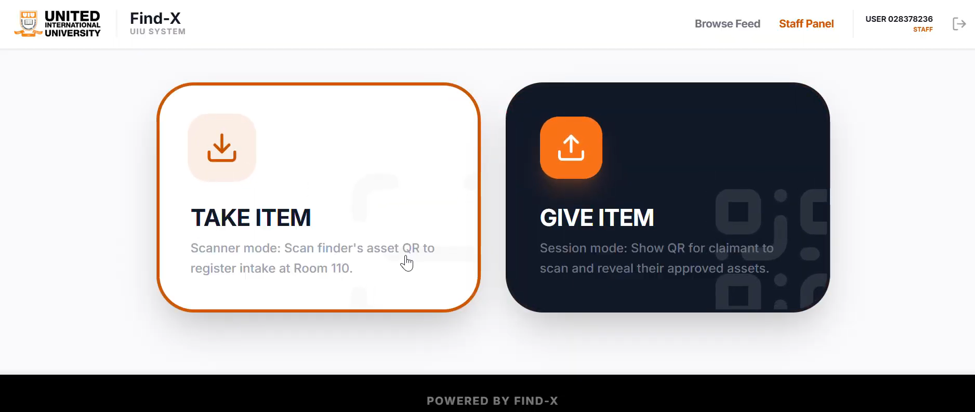

Slide 11
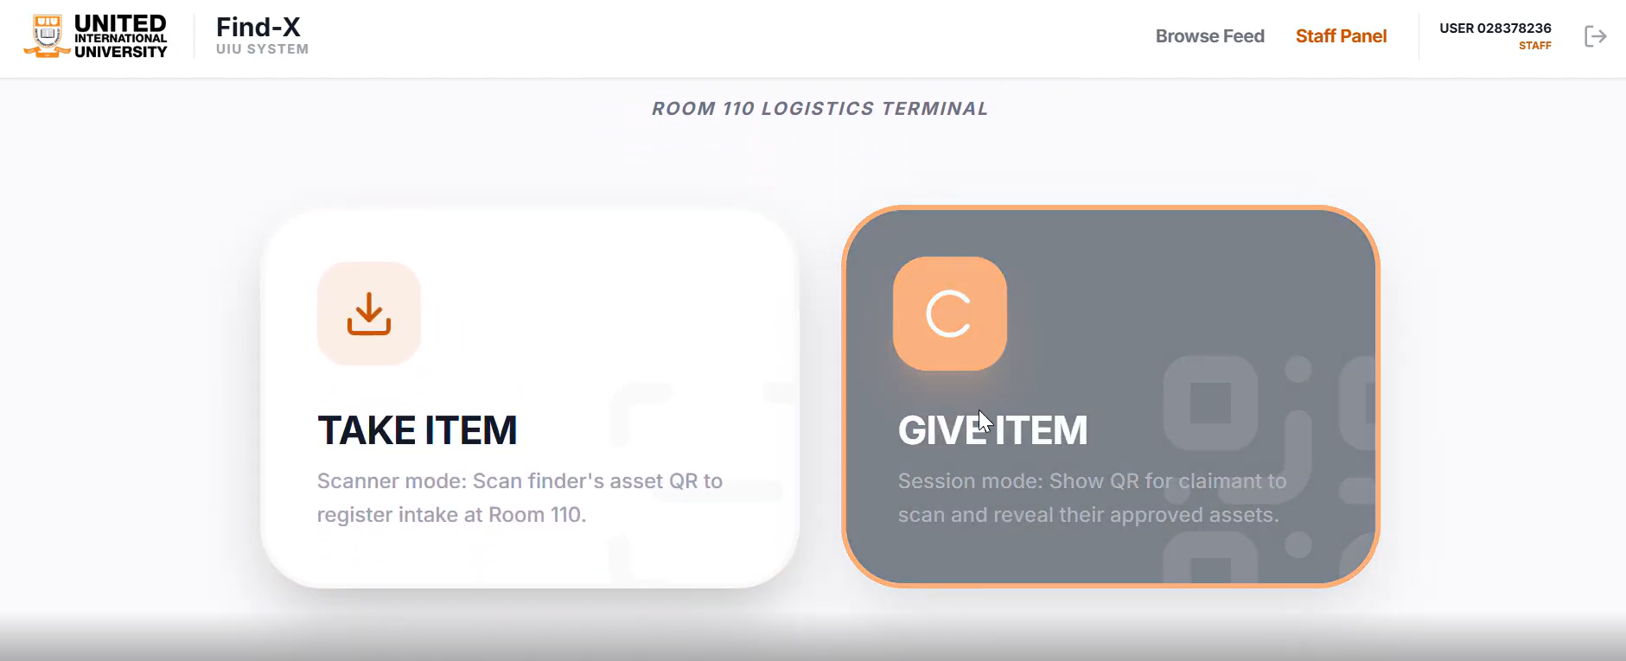
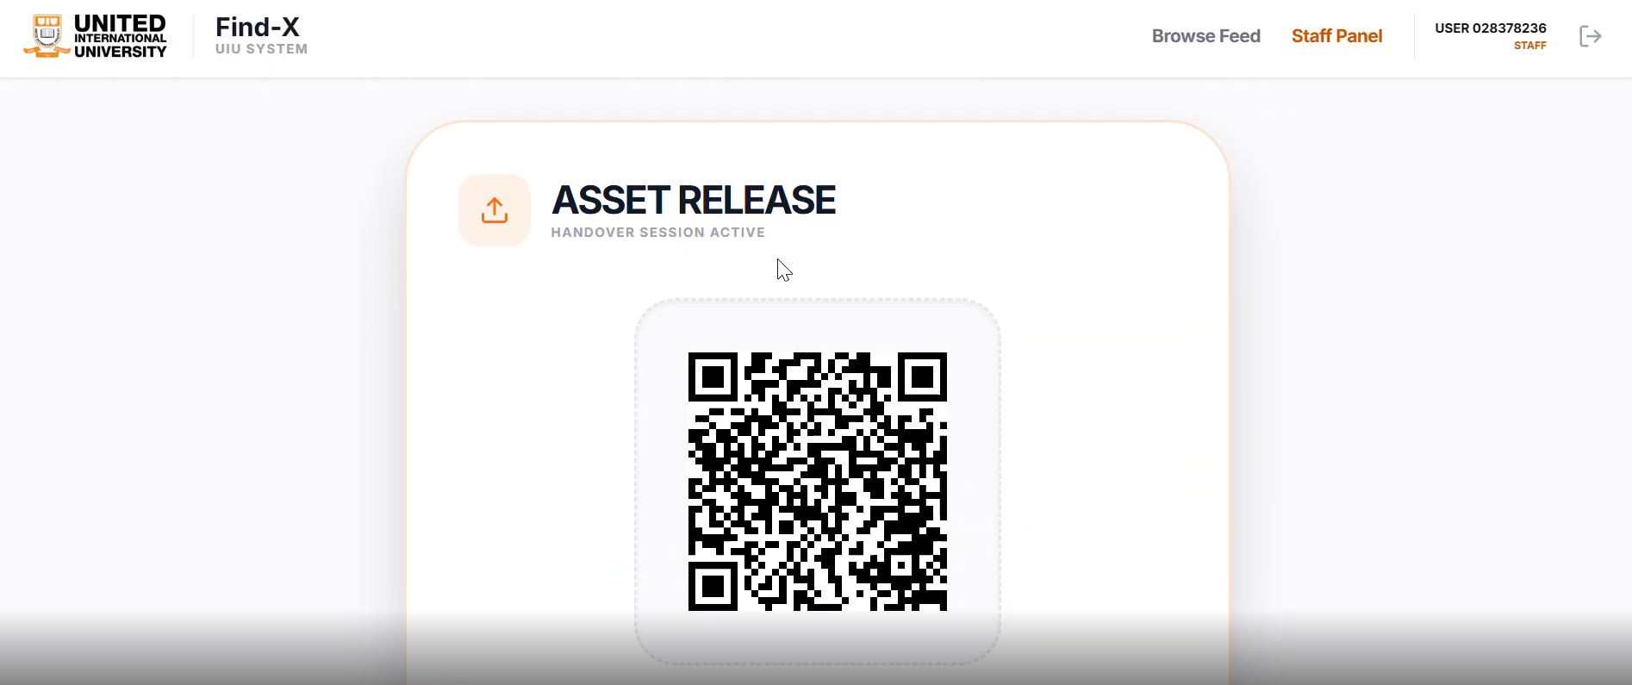
1.This image shows the Staff Panel of the Find-X system. Staff use Take Item to register found items by scanning a QR code, and Give Item to return approved items to the rightful owner.
2.This image shows the Asset Release process. A QR code is used to verify the claimant and
securely hand over the item.”

Slide 12
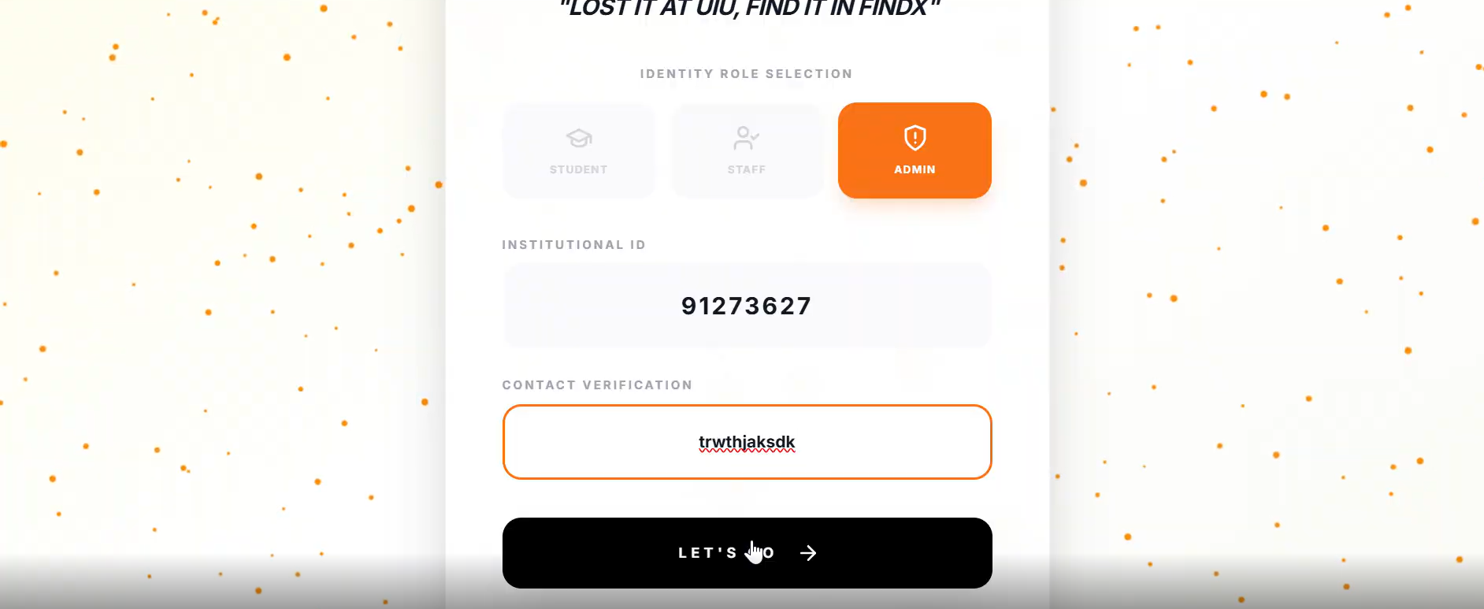
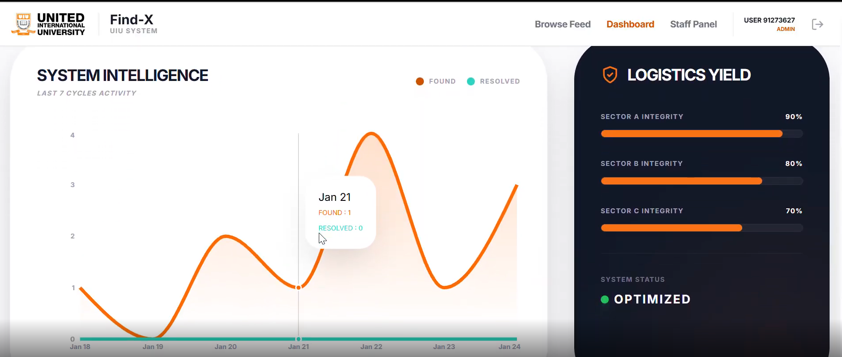
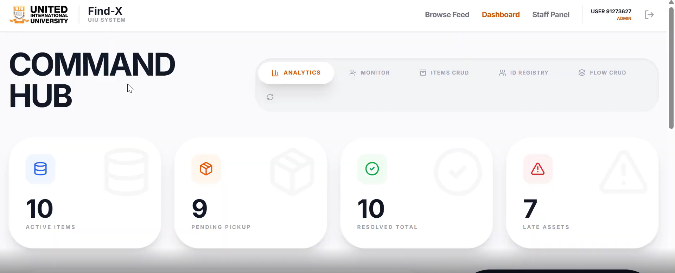

Slide 13
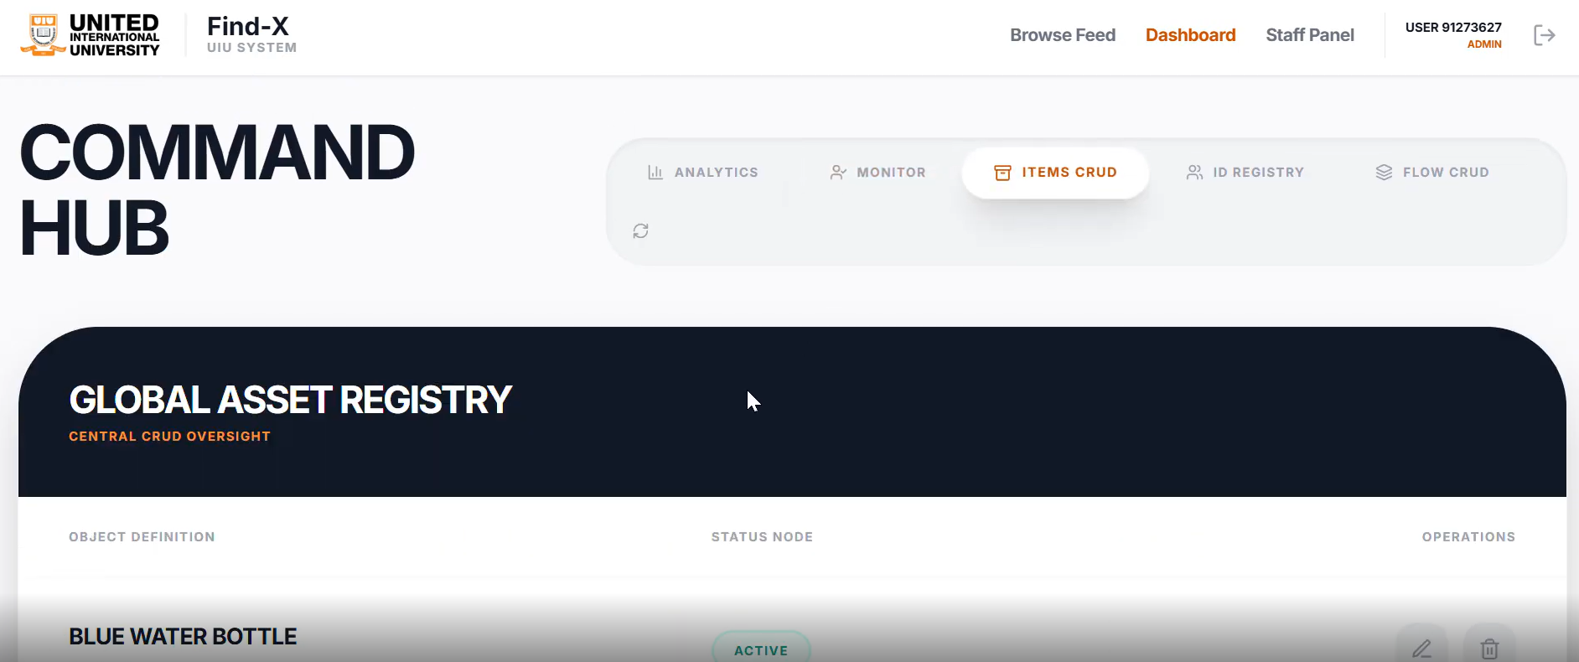
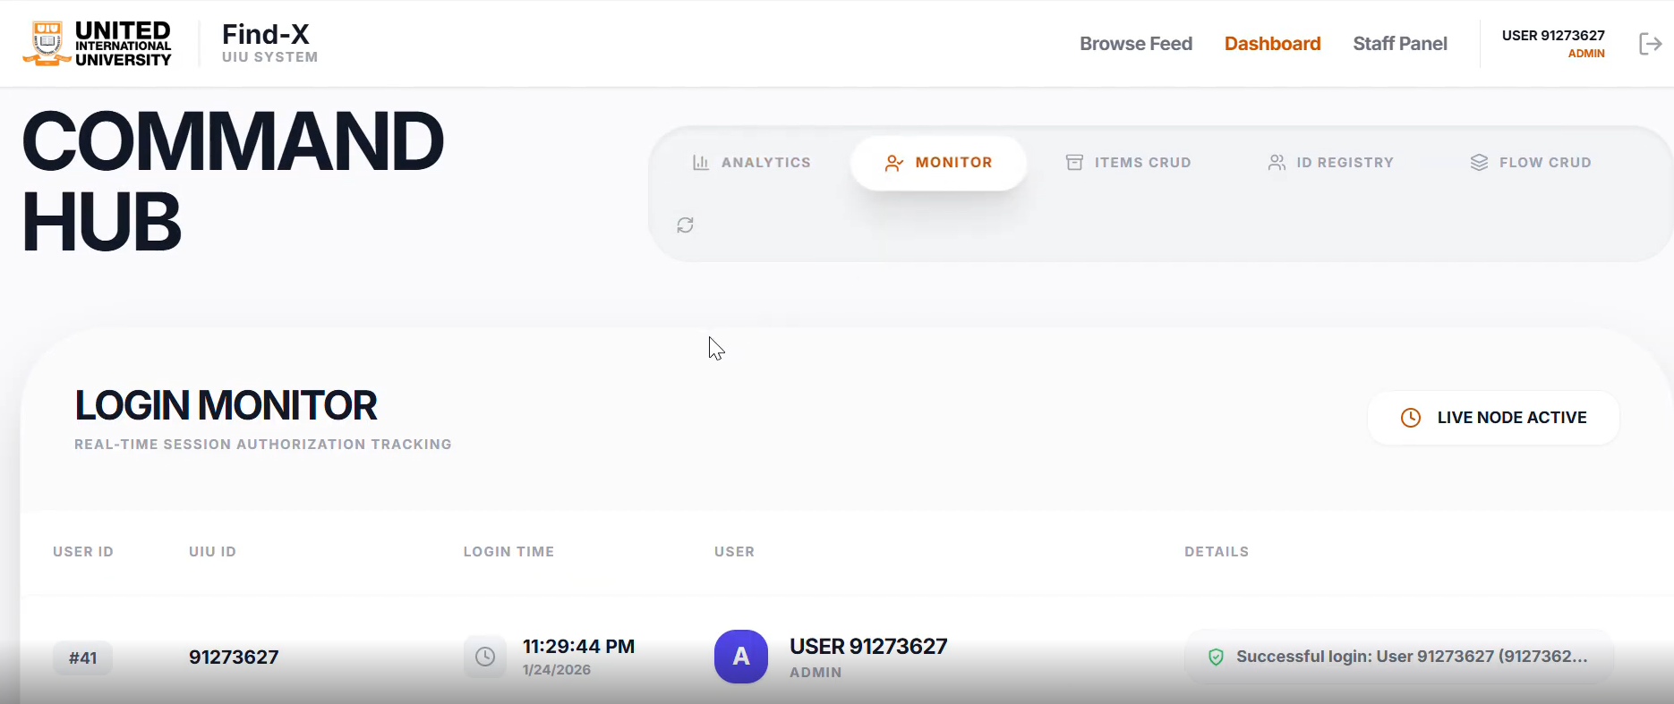
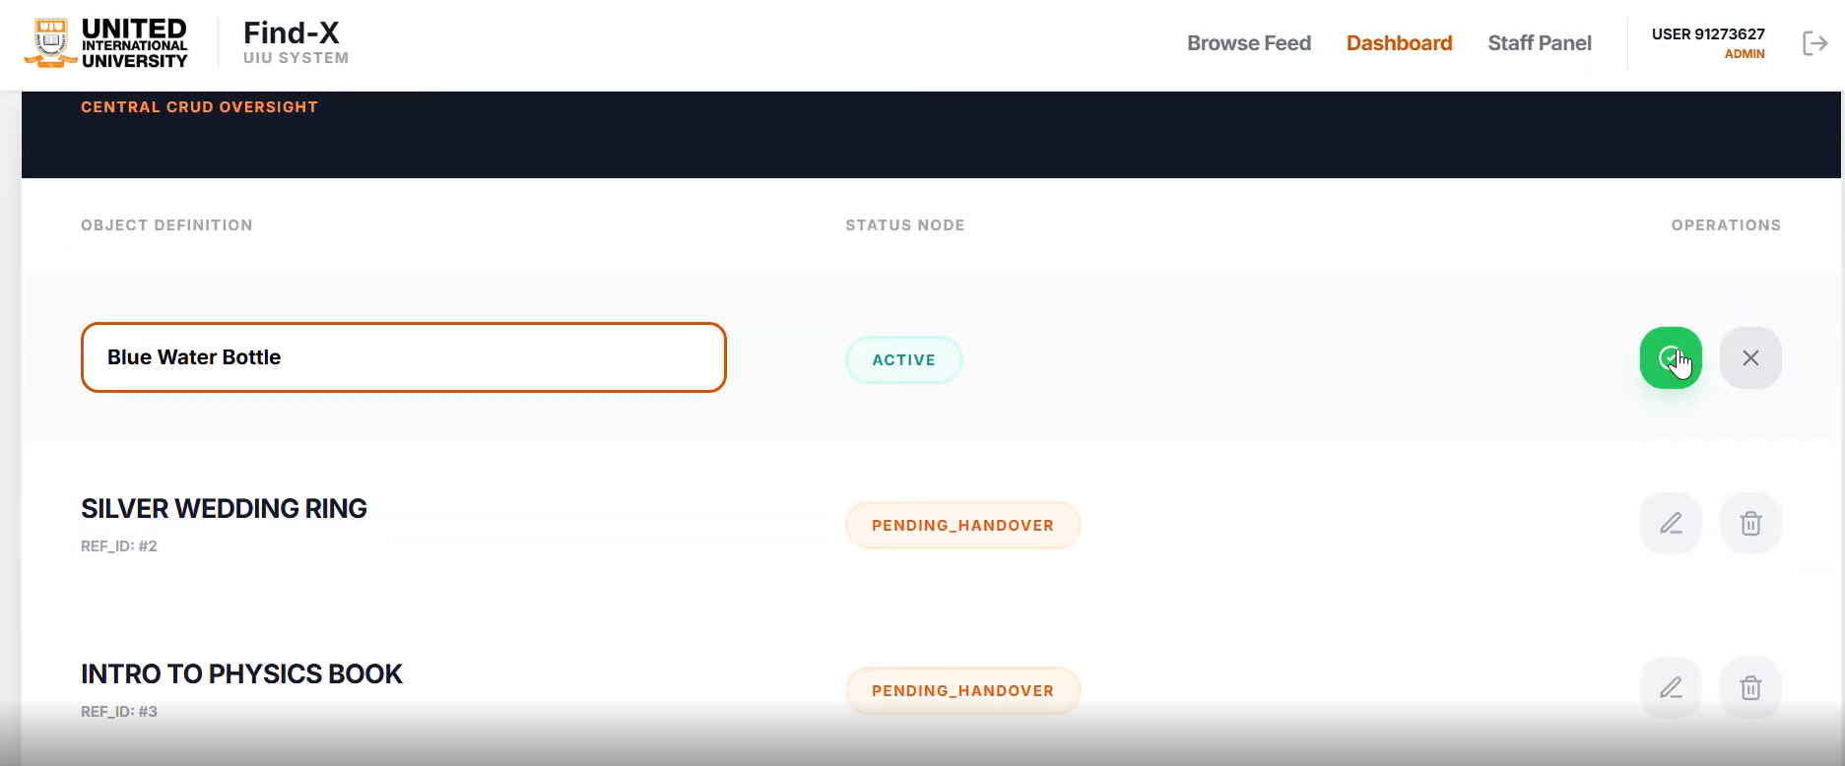

Slide 14
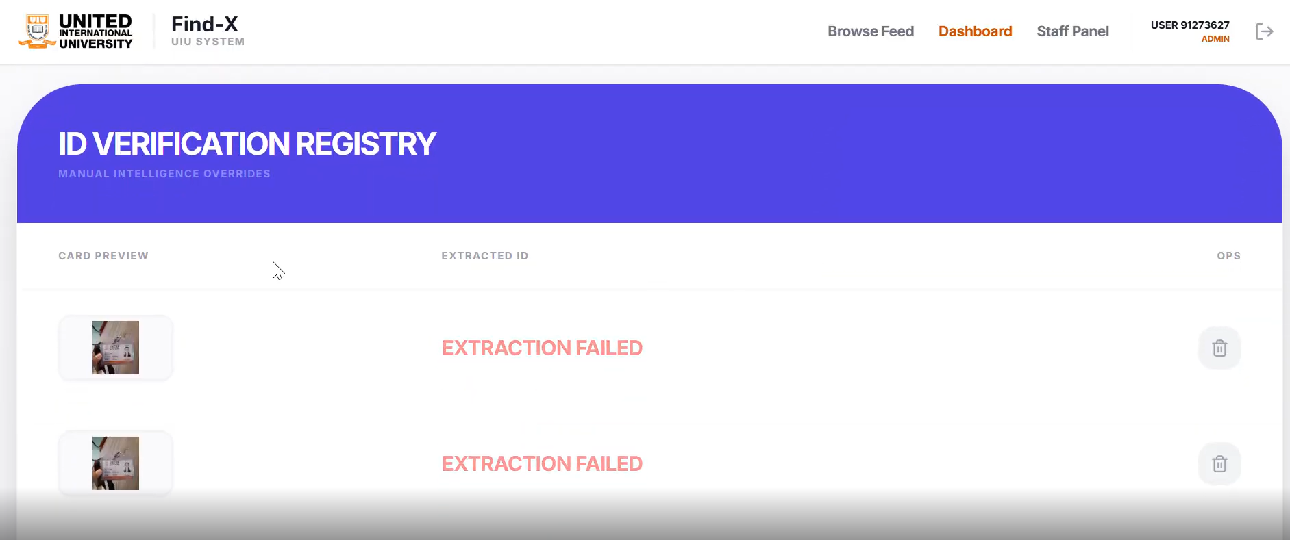
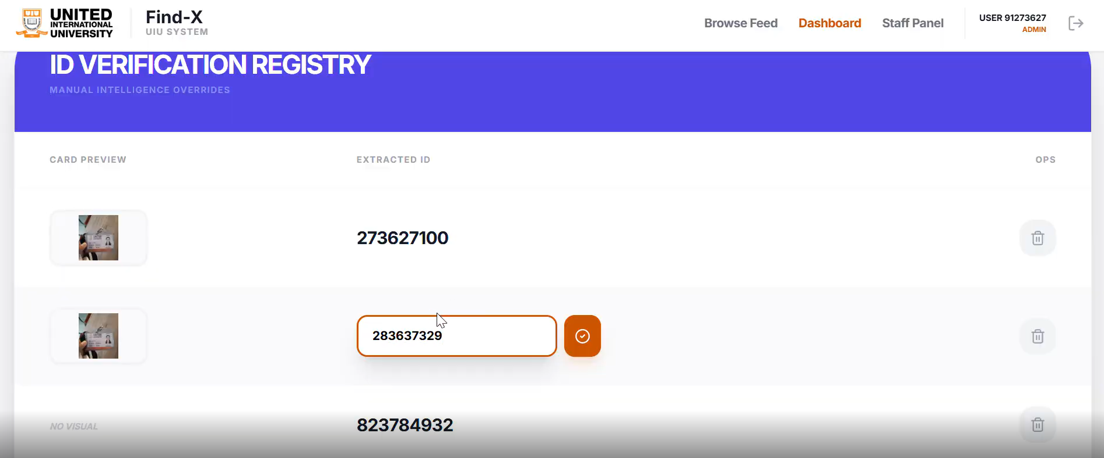
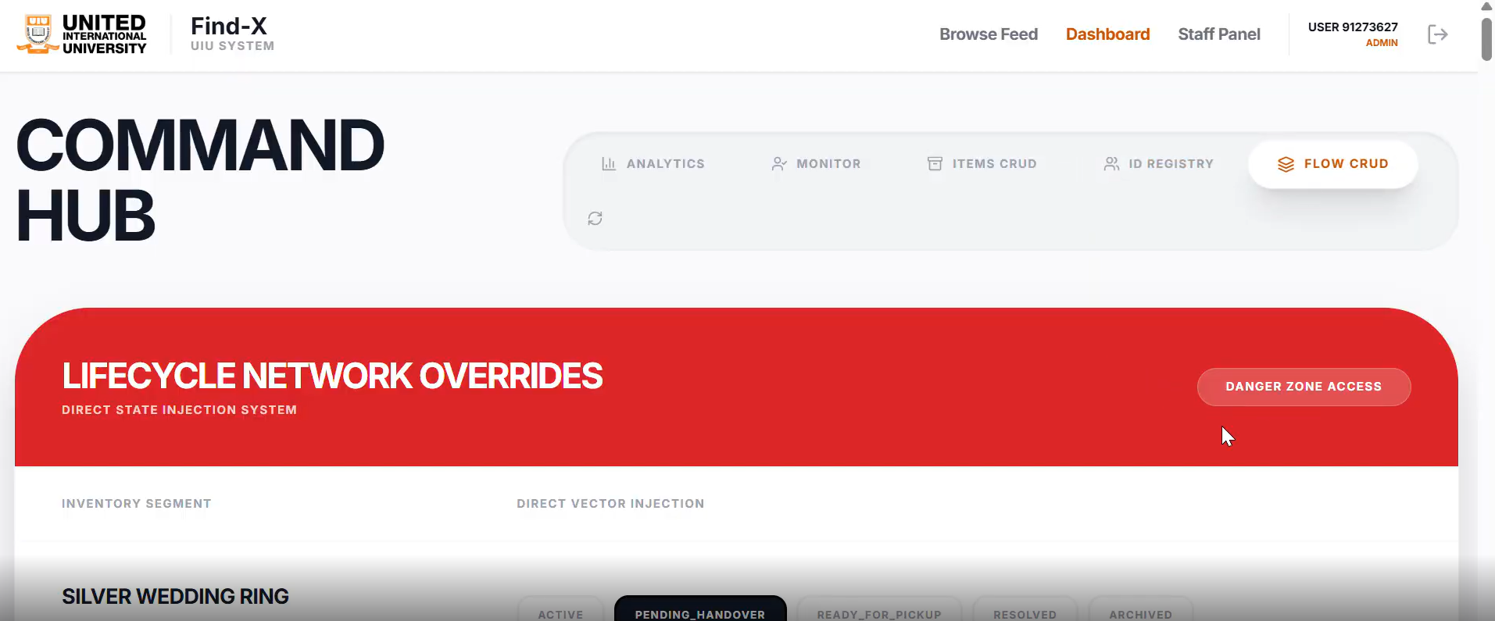
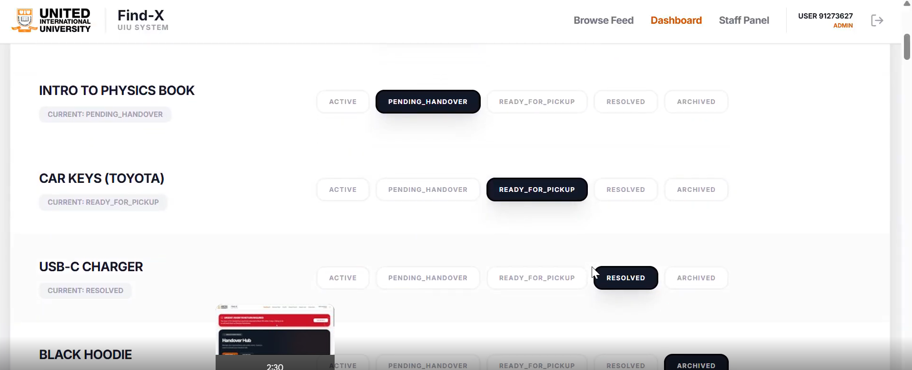
This slide shows the ID Verification Registry where the system attempts to extract ID information for verification. If extraction fails, it is clearly marked for review.
Here, staff can manually verify and confirm the extracted ID number to approve a claim
This slide represents the Command Hub, where administrators can monitor items and manage system-level controls and overrides.
This slide shows the item lifecycle, displaying different states such as active, pending handover, ready for pickup, and resolved.

Slide 15
Find-X : Database Schema Overview
User & Master Data User | Category | Location
Lost & Found Core Item | LostItem | ItemImage
Claim & Recovery Claim | QuizLog | RecoveryOTP | HandoverSession | Dispute
AI, Logs & Support FastIDItem | FastIDMatch | CVScanResult | AuditLog | Notification
Core Relationship Flow User → Item → Claim → Logs FastID tables link Lost & Found IDs
Design Note Relational | Normalized | Secure | DB-Driven

Slide 16
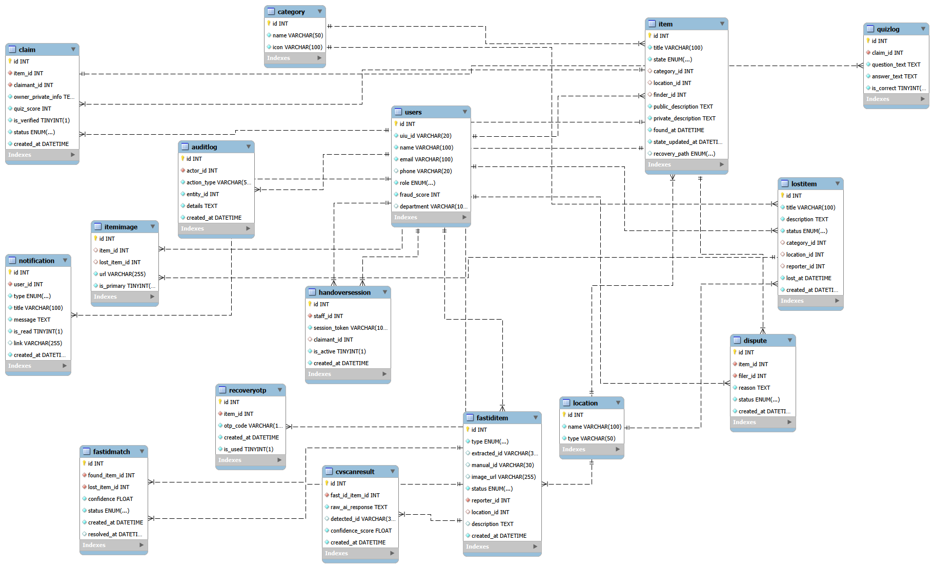

Slide 17
THANK YOU

